Slide 1
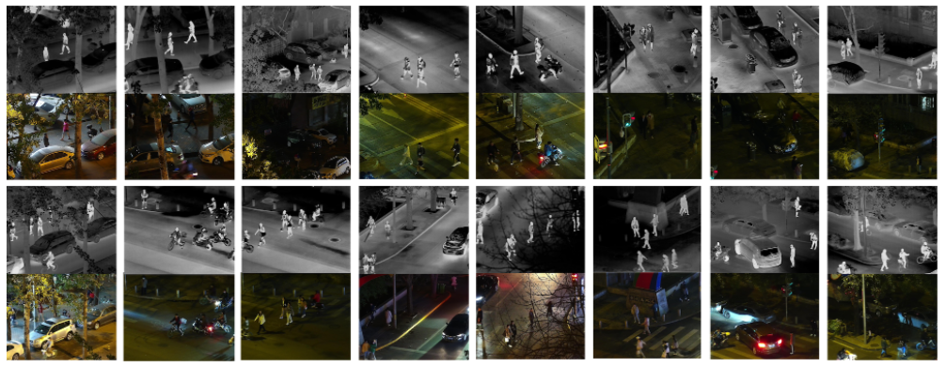
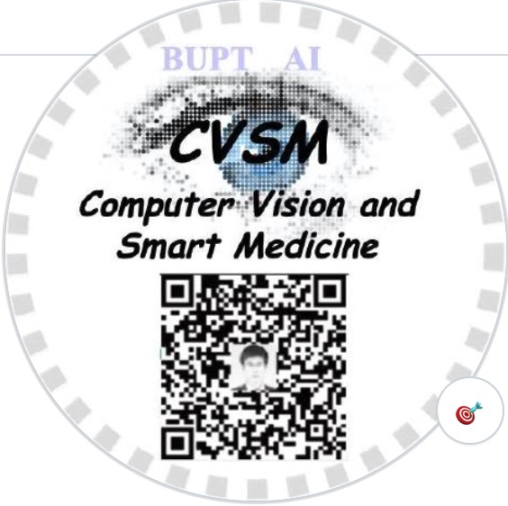
LLVIP: A Visible-infrared Paired Dataset for Low-light Vision
https://bupt-ai-cz.github.io/LLVIP/
15488 pairs
(30976 images)
41579 labels
ICCV 2021 Workshop RLQ
Xinyu Jia, Chuang Zhu*, Minzhen Li, Wenqi Tang, Wenli Zhou
Beijing University of Posts and Telecommunications
Beijing, China
Notes:
Hello everyone, I am Jia Xinyu, from Beijing University of Posts and Telecommunications, China. Now I will introduce our paper, LLVIP: A Visible-infrared Paired Dataset for Low-light Vision presented at RLQ to you. In this paper, we presented a large scale and significant dataset.

Slide 2
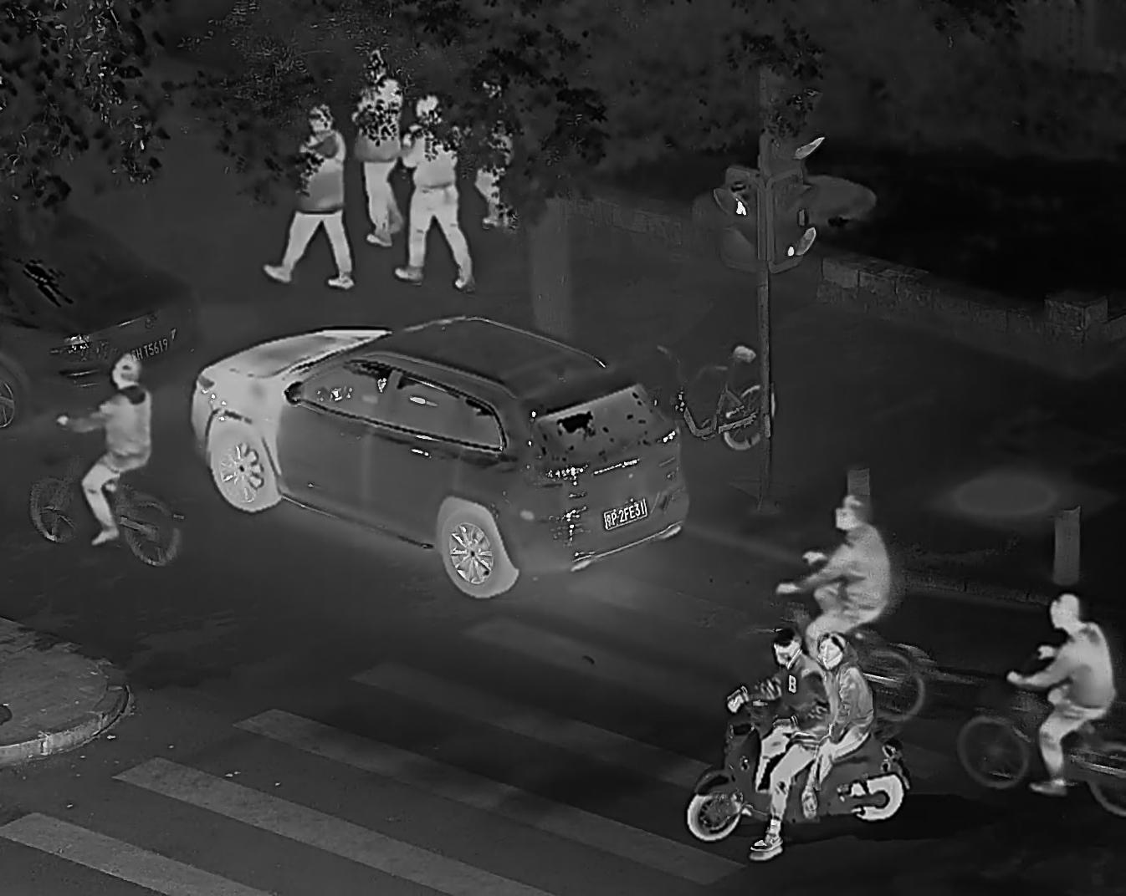
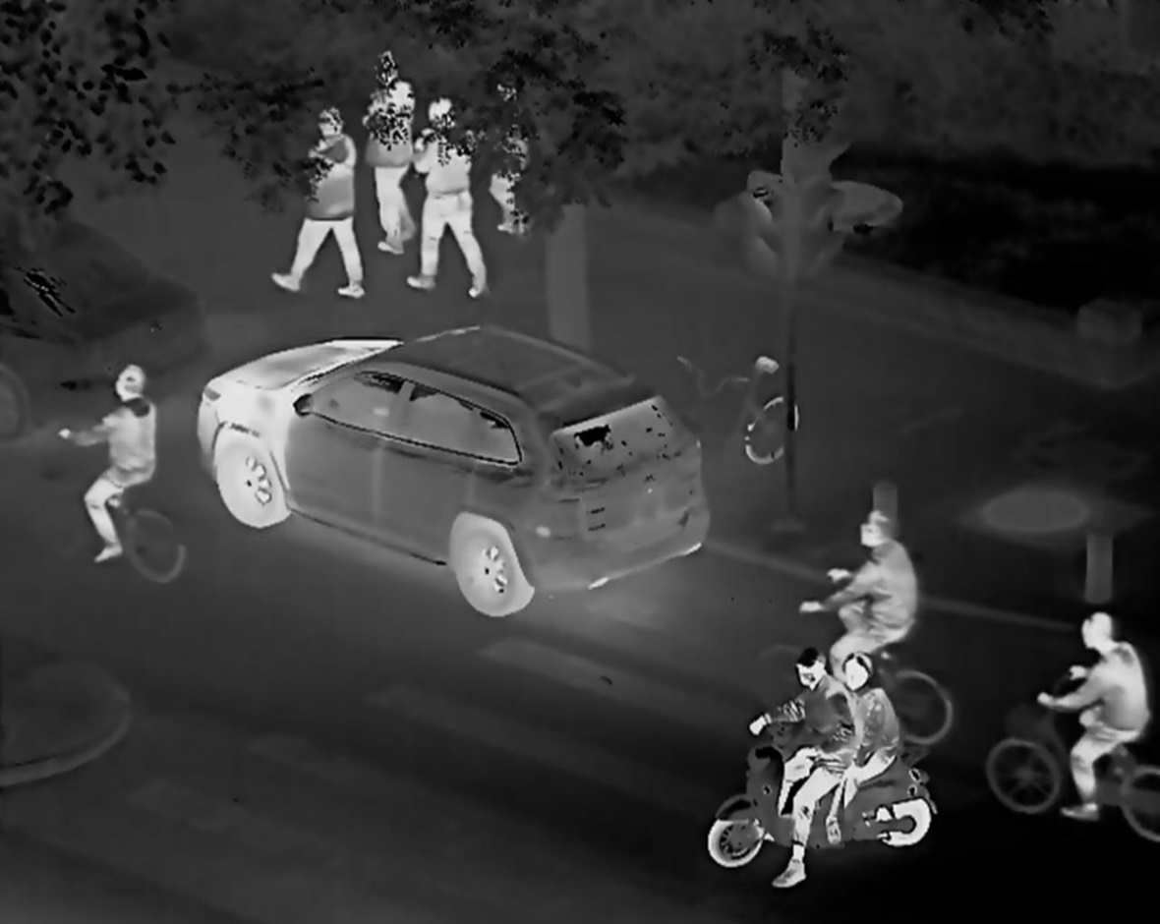
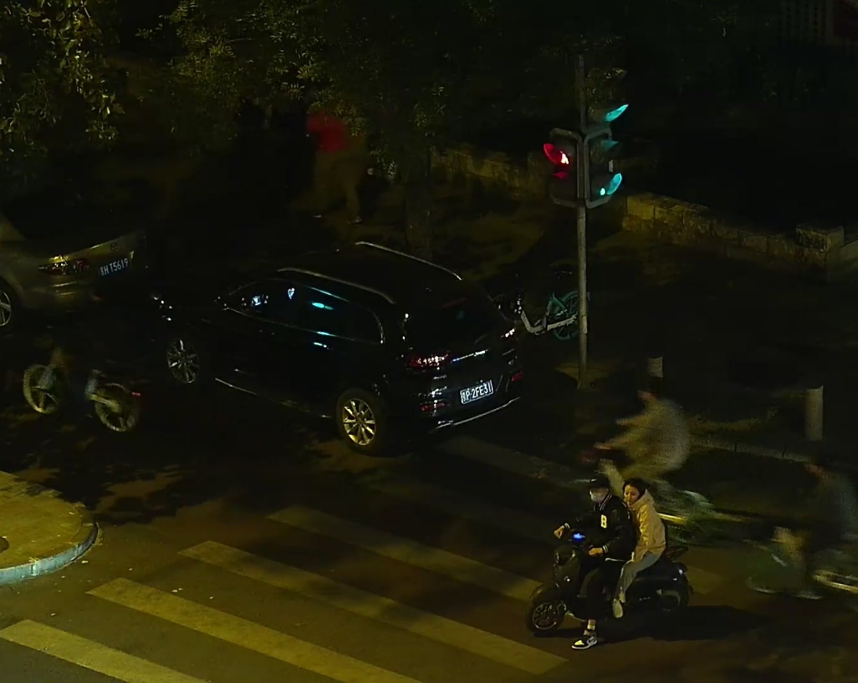
Why this dataset?
Notes:
This is a picture that we might use, 点 but we can’t see people clearly because it is too dark.
点 But on that picture, 点 now the people are so obvious, and we finally realize that there are people in the upper left corner of the picture. This is an infrared image. 点 But we can’t see the details of objects from it.
点 So let‘s look at this, it not only clearly shows where the people are, 点 but also has rich texture details. It is a fusion of visible and infrared images.

Slide 3
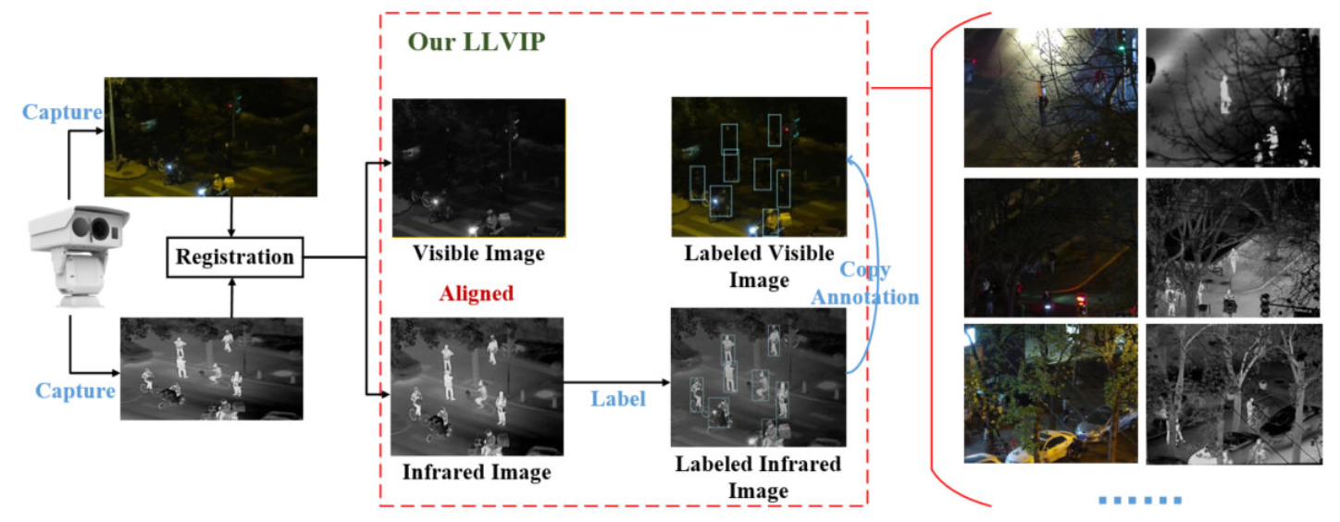
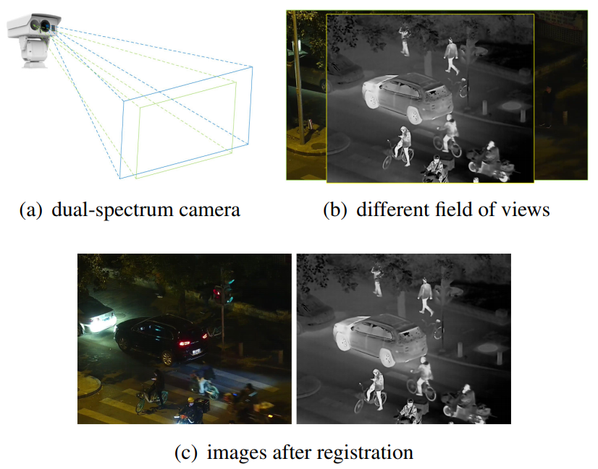
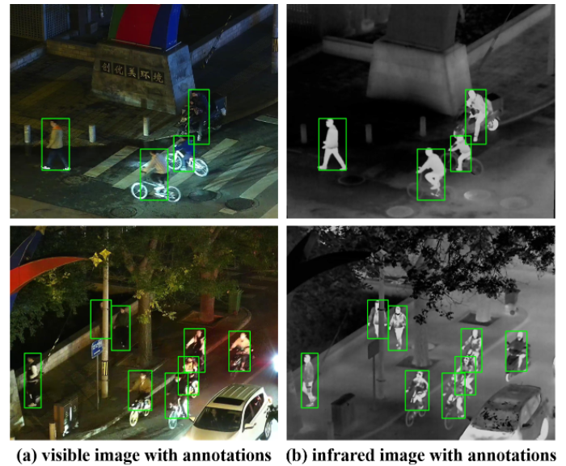
LLVIP
①
④
②
③
Registration
15488 pairs
(30976 images)
41579 labels
Annotation
Notes:
So we built the dataset LLVIP, a visible-infrared paired dataset for low-light vision.
点 Firstly, we used a binocular camera platform that consist of a visible light camera and a infrared camera to capture images. The wave band of infrared light is eight to fourteen micron.
点 Then we applied a semi-manual method to image registration, that is, manually select several pairs of points that need to be aligned between the two images, then calculate the projection transformation to deform the infrared image.
As for annotation, 点 we labeled pedestrians on infrared images where they are obvious. 点 Then because the visible and the infrared are aligned, the annotations can be copied directly to the visible images.
So far, our dataset contains a total of fifteen thousand four hundred and eighty-eight pairs of images and forty-one thousand five hundred and seventy-nine pedestrian labels.

Slide 4
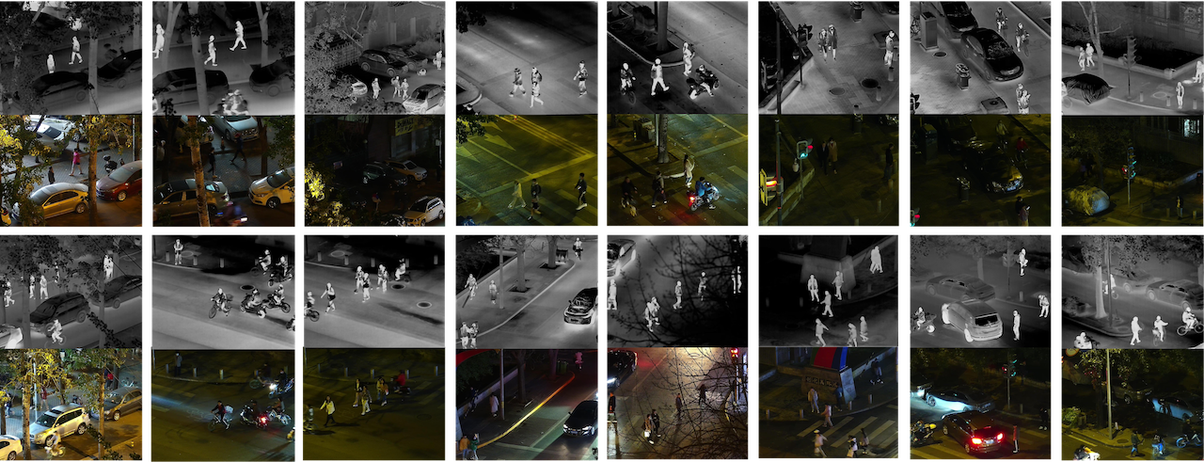
Comparison
Advantages:
Large number and high resolution
Visible and infrared images are aligned
Low-light conditions
A large number of pedestrian
Notes:
Let‘s take a look at how our dataset compares to other datasets.
点 It has the largest number, the highest resolution.
点 All visible and infrared images are aligned, so they can be used for image fusion and supervised image-to-image translation.
点 The dataset is under low-light conditions, so the role of infrared is more prominent.
点 LLVIP contains a large number of pedestrian, so it can be useful in pedestrian detection task.
The other datasets are also excellent, but they all have some weaknesses that make them difficult to apply to many tasks.

Slide 5
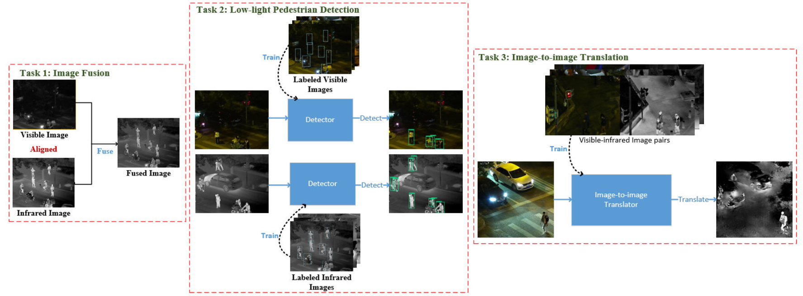
Tasks
Task 1: Image Fusion
Task 3: Image-to-image Translation
Task 2: Low-light Pedestrian Detection
Notes:
It is interesting to see which computer vision tasks the LLVIP can be used to study. Here we show the application of three vision tasks to the dataset. Image fusion, low-light pedestrian detection and image-to-image translation.

Slide 6
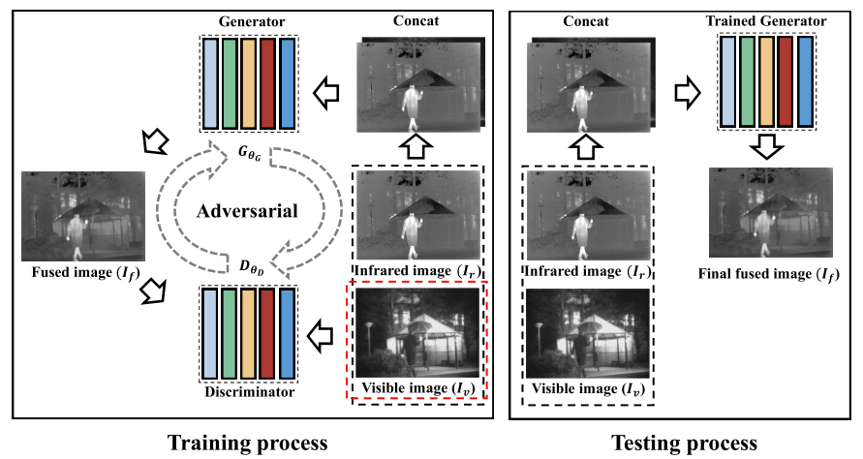
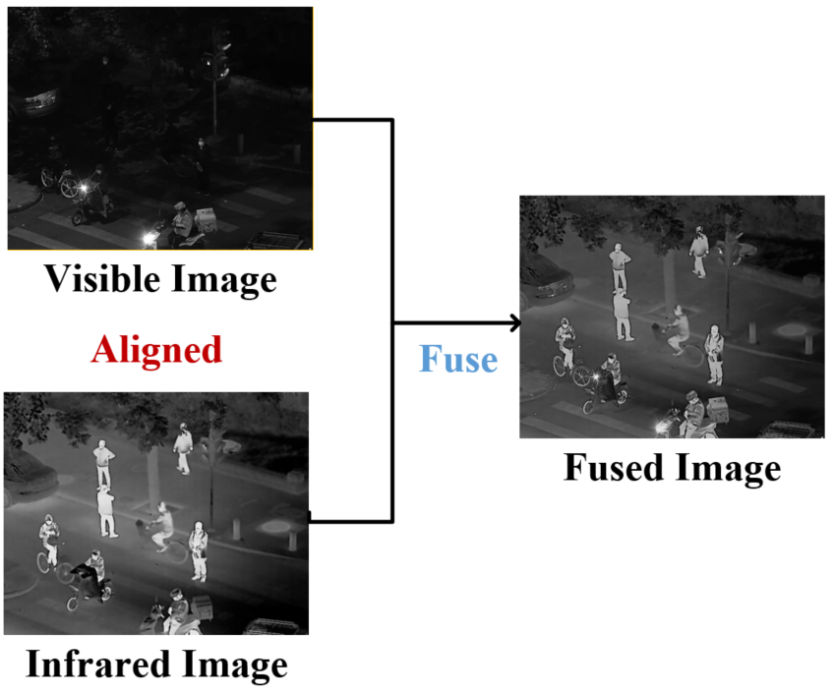
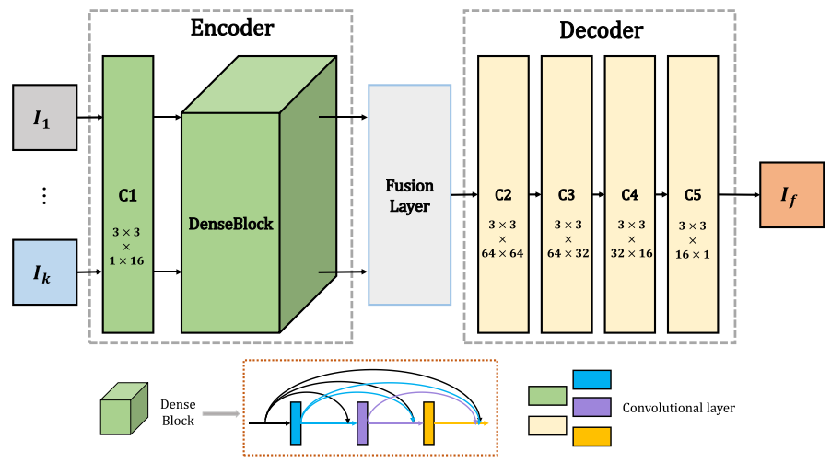
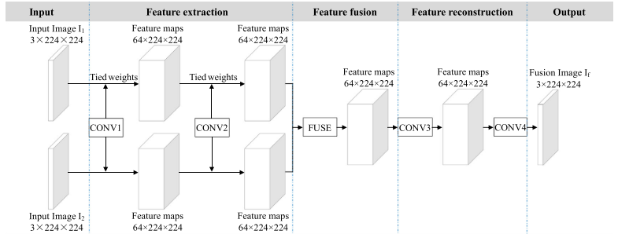
Tasks 1: Image Fusion
GTF
FusionGAN
DenseFuse
IFCNN
Notes:
Image Fusion attempts to extract salient features from source images, then these features are integrated into a single image by appropriate fusion method. The fusion of visible and infrared can obtain both the rich details of visible images and the prominence of heat source targets in infrared.
We evaluated the performance of some popular fusion algorithms including GTF, FusionGAN, DenseFuse and IFCNN on the dataset.

Slide 7
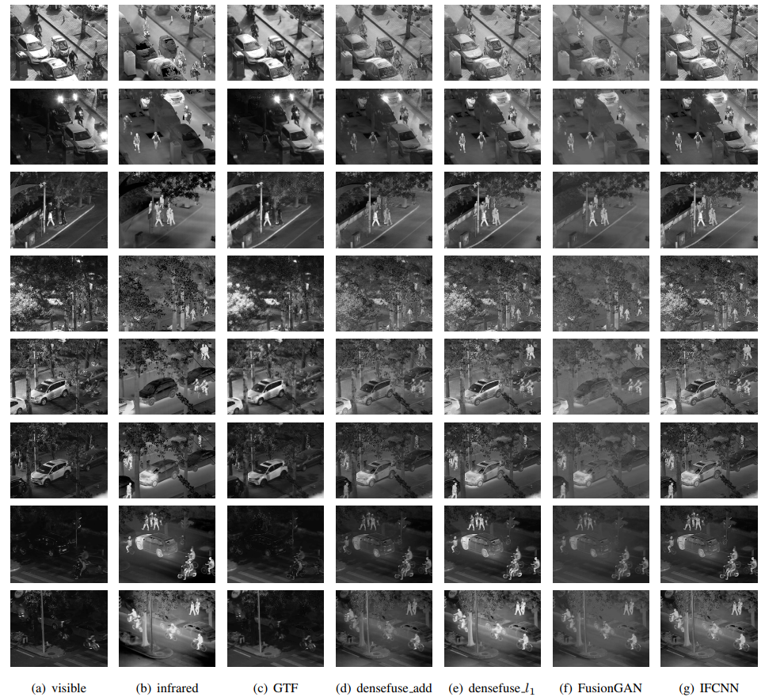
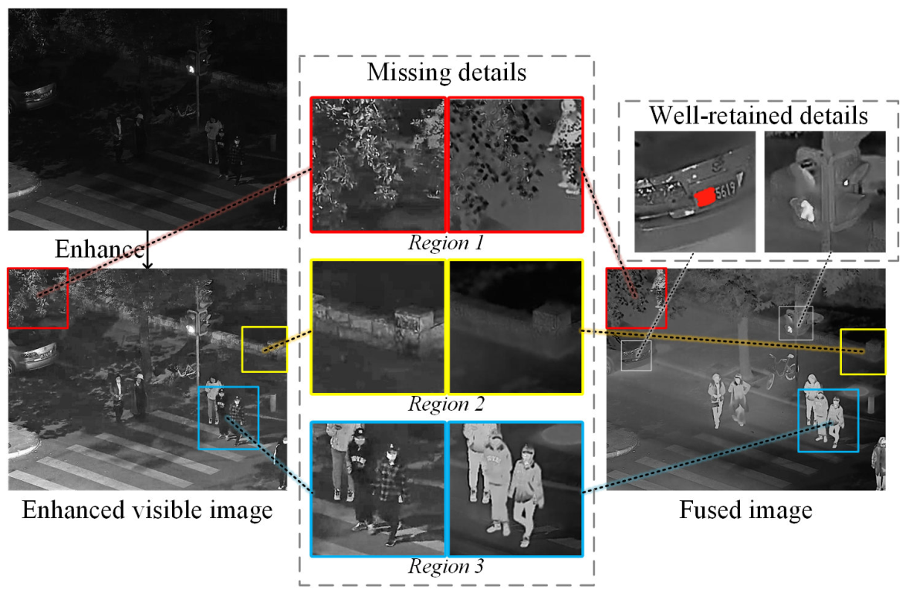
Tasks 1: Image Fusion
Notes:
The picture on the right shows some examples of source images and fused images. Fusion algorithms combine the information of the two kinds of images, so that human bodies are highlighted and the images contain some texture information.
We compare the details in the fused image and the enhanced visible image in the picture on the left. There are some missing details in the fused image when the visible is too dark or the infrared is too bright. That is to say, the ability of fusion algorithm to balance two source images is poor. This demonstrates that the existing fusion algorithms still have great room for improvement.
We also provide the average value of six metrics of different fusion algorithms.

Slide 8
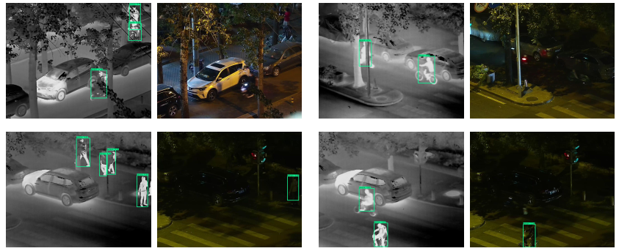
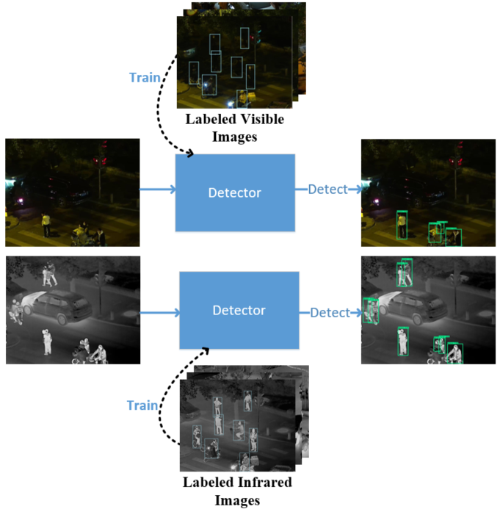
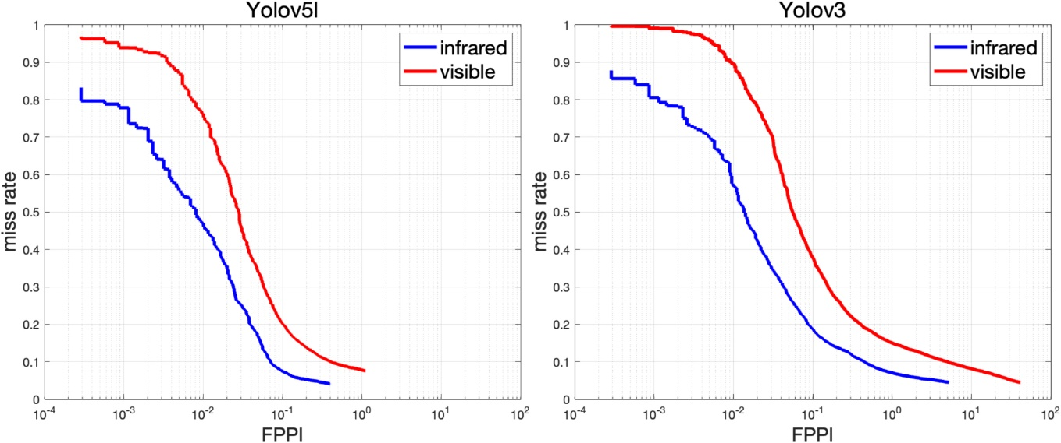
Tasks 2: Low-light Pedestrian Detection
log average miss rate | Yolov5l | Yolov3
visible | 22.59% | 37.70%
infrared | 10.66% | 19.73%
 | Yolov5l |  |  | Yolov3
 | AP50 | AP75 | AP | AP50 | AP75 | AP
visible | 0.908 | 0.564 | 0.527 | 0.871 | 0.455 | 0.466
infrared | 0.965 | 0.764 | 0.670 | 0.940 | 0.661 | 0.582
https://github.com/bupt-ai-cz/LLVIP
Notes:
The second task is low-light pedestrian detection. Although pedestrian detection algorithms have improved a lot in recent years, the performance remains limited in poor light conditions, and there are few methods and datasets for low-light. We solved the problem that visible image is difficult to label by labeling the infrared of registration.
We evaluated the performance of yolov5l and yolov3 on visible and infrared images respectively. It can be clearly seen from AP and detection result images that the detection performance of visible image in low light condition still lags behind that of infrared. We also drew the miss rate-FPPI curve based on the test results and calculated log average miss rate. It can also be seen that there is still a lot of room for improvement in pedestrian detection of visible images in low light conditions. These charts are on our Github.

Slide 9
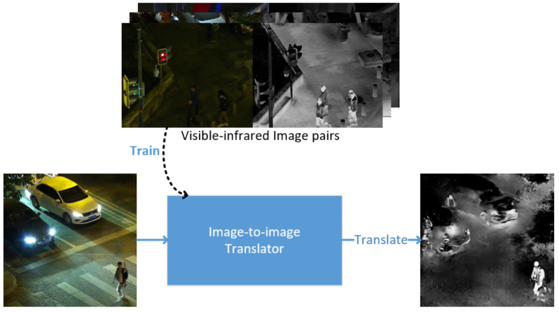
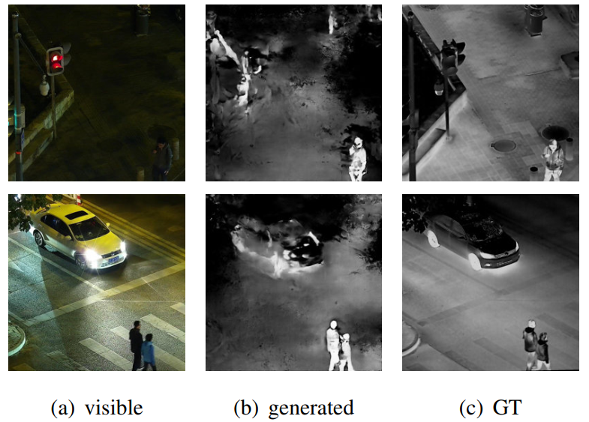
Tasks 3: Image-to-image Translation
Dataset | SSIM | PSNR
KAIST | 0.6918 | 28.9935
LLVIP | 0.1757 | 10.7688
pix2pixGAN
Notes:
The third task is image-to-image translation, means converting visible images into infrared. We evaluated the pix2pixGAN on LLVIP, and it has shown very poor performance qualitatively and quantitatively. Obviously, the performance on LLVIP is much worse than on KAIST, because the scenarios of LLVIP training set and test set are different and the performance of pix2pixGAN decreases significantly in low light conditions.
The experiments of the three vision tasks show that it is very challenging for the algorithms in low-light conditions and they still needs to be improved. Our LLVIP dataset can help the researchers.

Slide 10
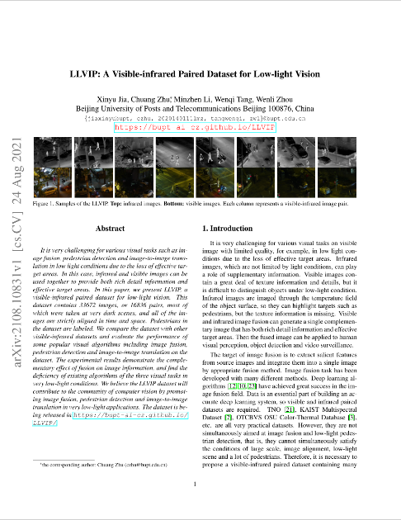
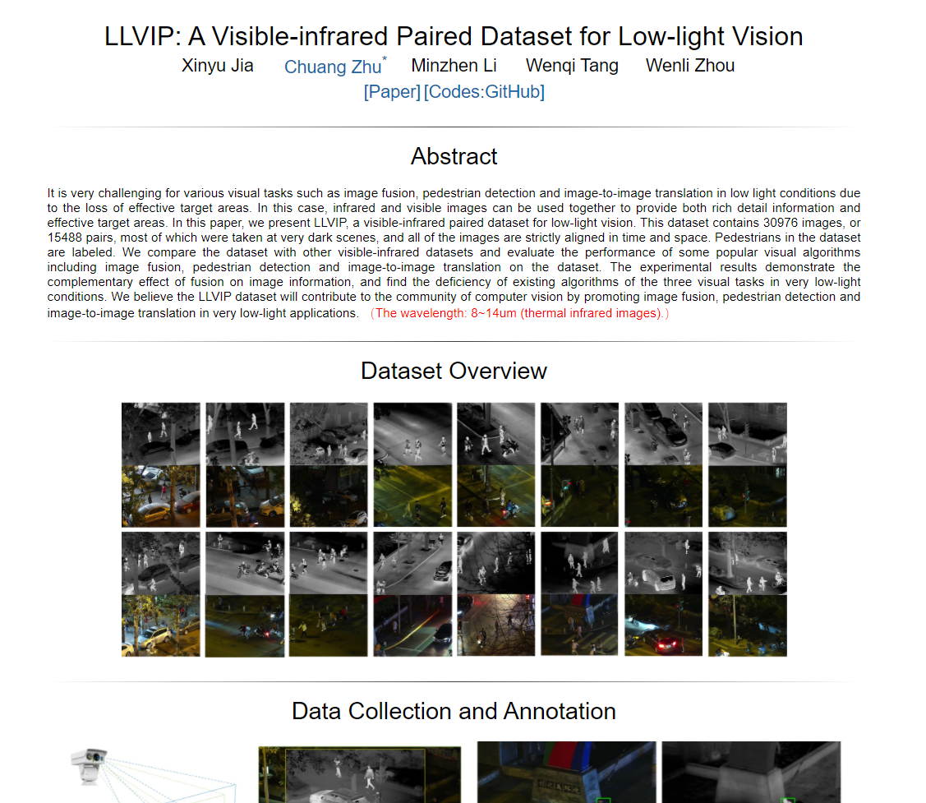
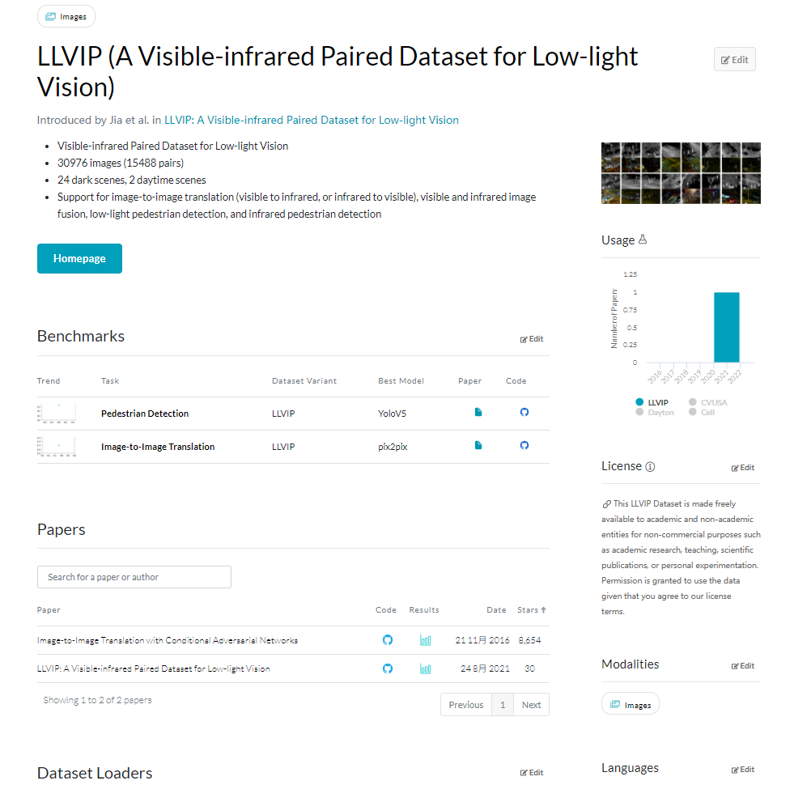
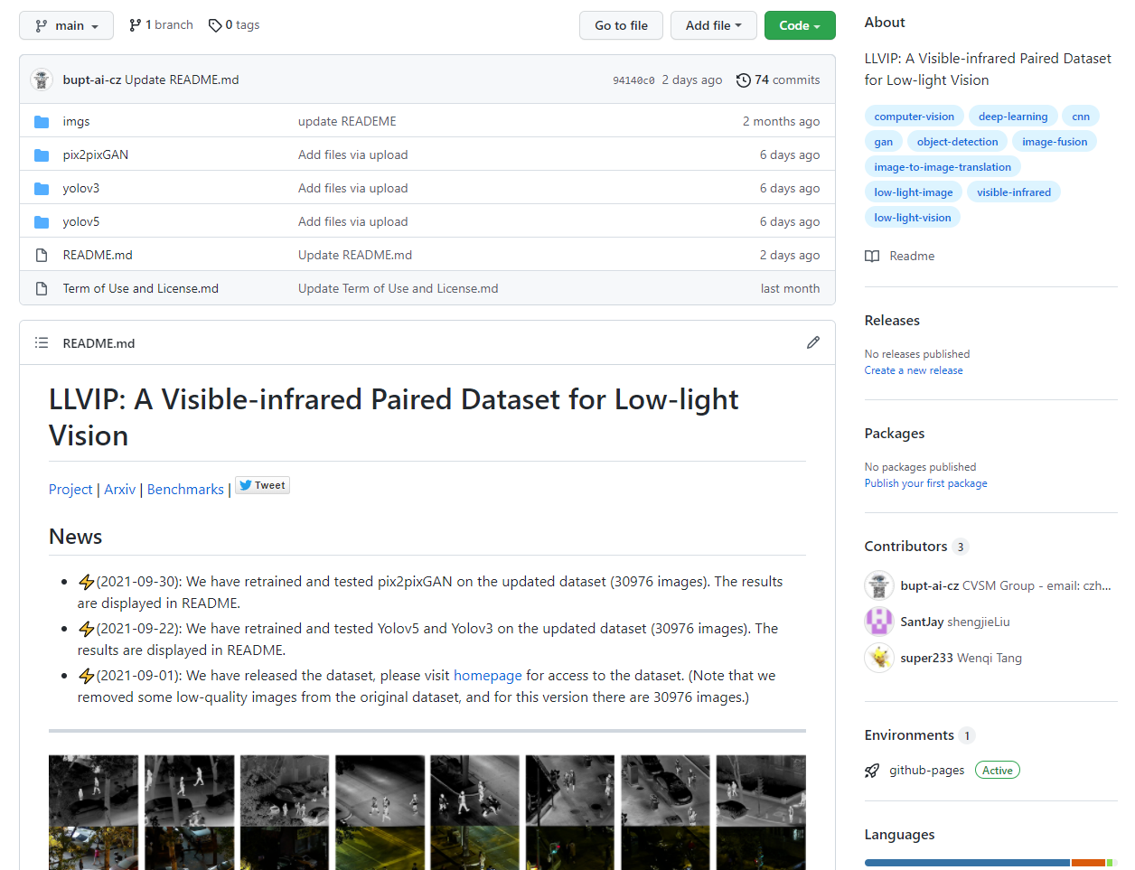
For More
paper
homepage
github
papers with code
arxiv.org/abs/2108.10831
bupt-ai-cz.github.io/LLVIP/
github.com/bupt-ai-cz/LLVIP
paperswithcode.com/dataset/llvip
email: czhu@bupt.edu.cn,
jiaxinyujxy@qq.com,
tangwenqi@bupt.edu.cn,
bupt.ai.cz@gmail.com
Notes:
For more information, you can visit our paper, our homepage, github or papers with code. And you can visit our homepage to download the dataset. If you have any question, please open an issue on our github or directly send us an email. Researchers are welcome to discuss and develop this dataset with us. Hope the LLVIP can contribute to the community of computer vision.

Slide 11
Thanks for watching!
Xinyu Jia, Chuang Zhu*, Minzhen Li, Wenqi Tang, Wenli Zhou
Notes:
Thanks for watching!

